Slide 1

MUHS-SIMULATION LAB MAHARASHTRA UNIVERSITY OF HEALTH SCIENCES
VISION :
Advancing Medical Education Through Innovation
Supporting medical fraternity in delivering high-impact experiential learning using task trainers and high fidelity simulators.
Imparting technical clinical skills, fostering interprofessional collaboration and improving patient safety
MISSION :
Improving patient safety through repetitive training of clinical skills in safe environment of simulation lab
Bridging theory & practice: Empowering lifelong learning to achieve excellence providing skill lab facilities to medical colleges having limited resources for skill lab by conducting workshops for them at MUHS or through mobile skill lab
OBJECTIVES :
1. Enhanced clinical competency
2. Improved patient safety
3. Interdisciplinary teamwork
4. Research and innovation
5. Confidence building

Slide 2
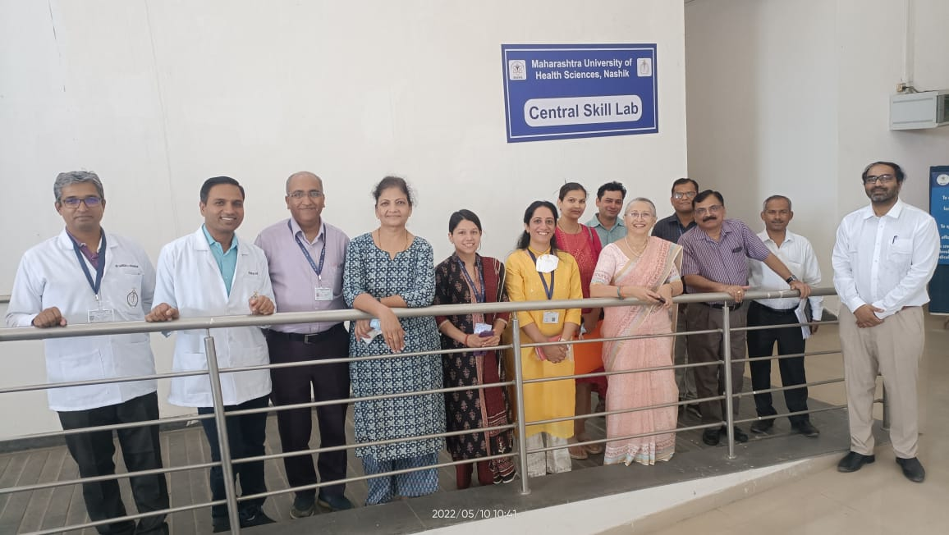
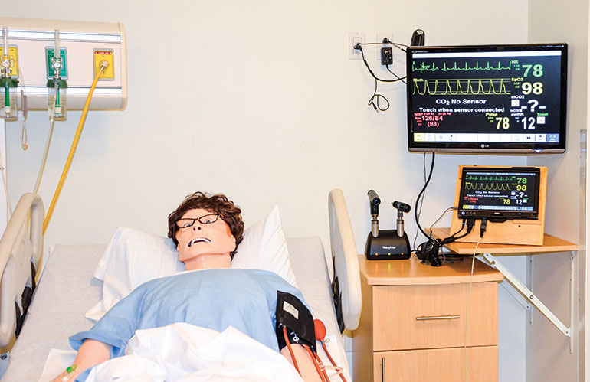
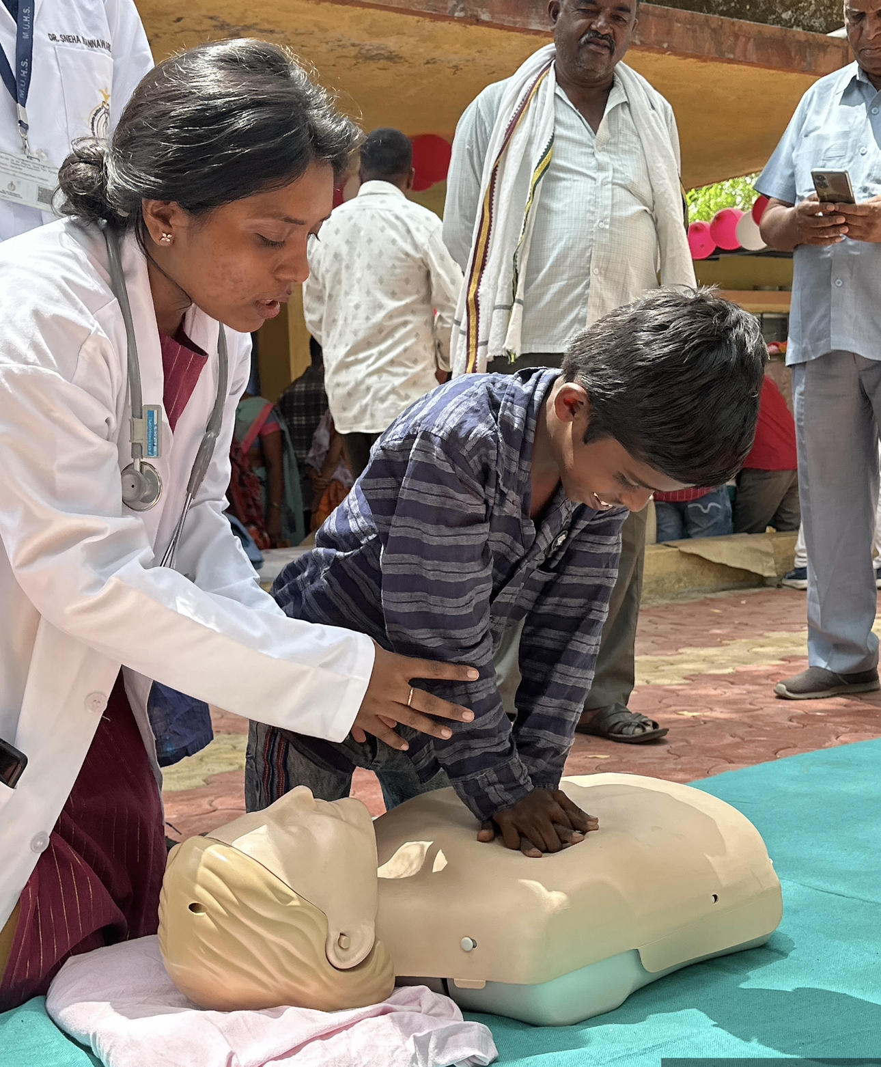
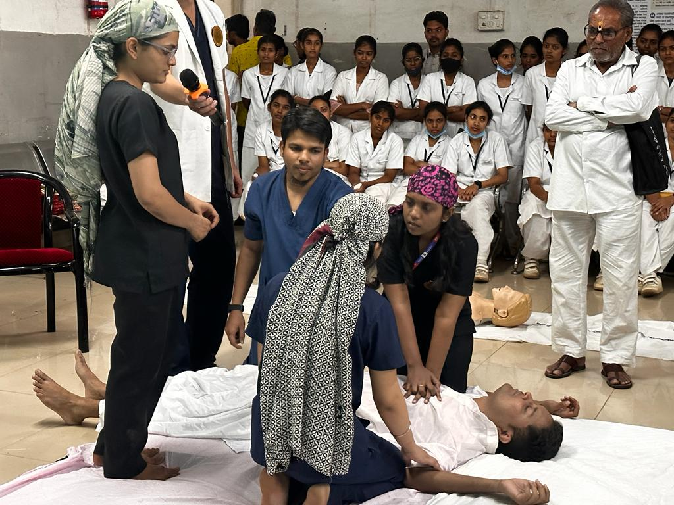
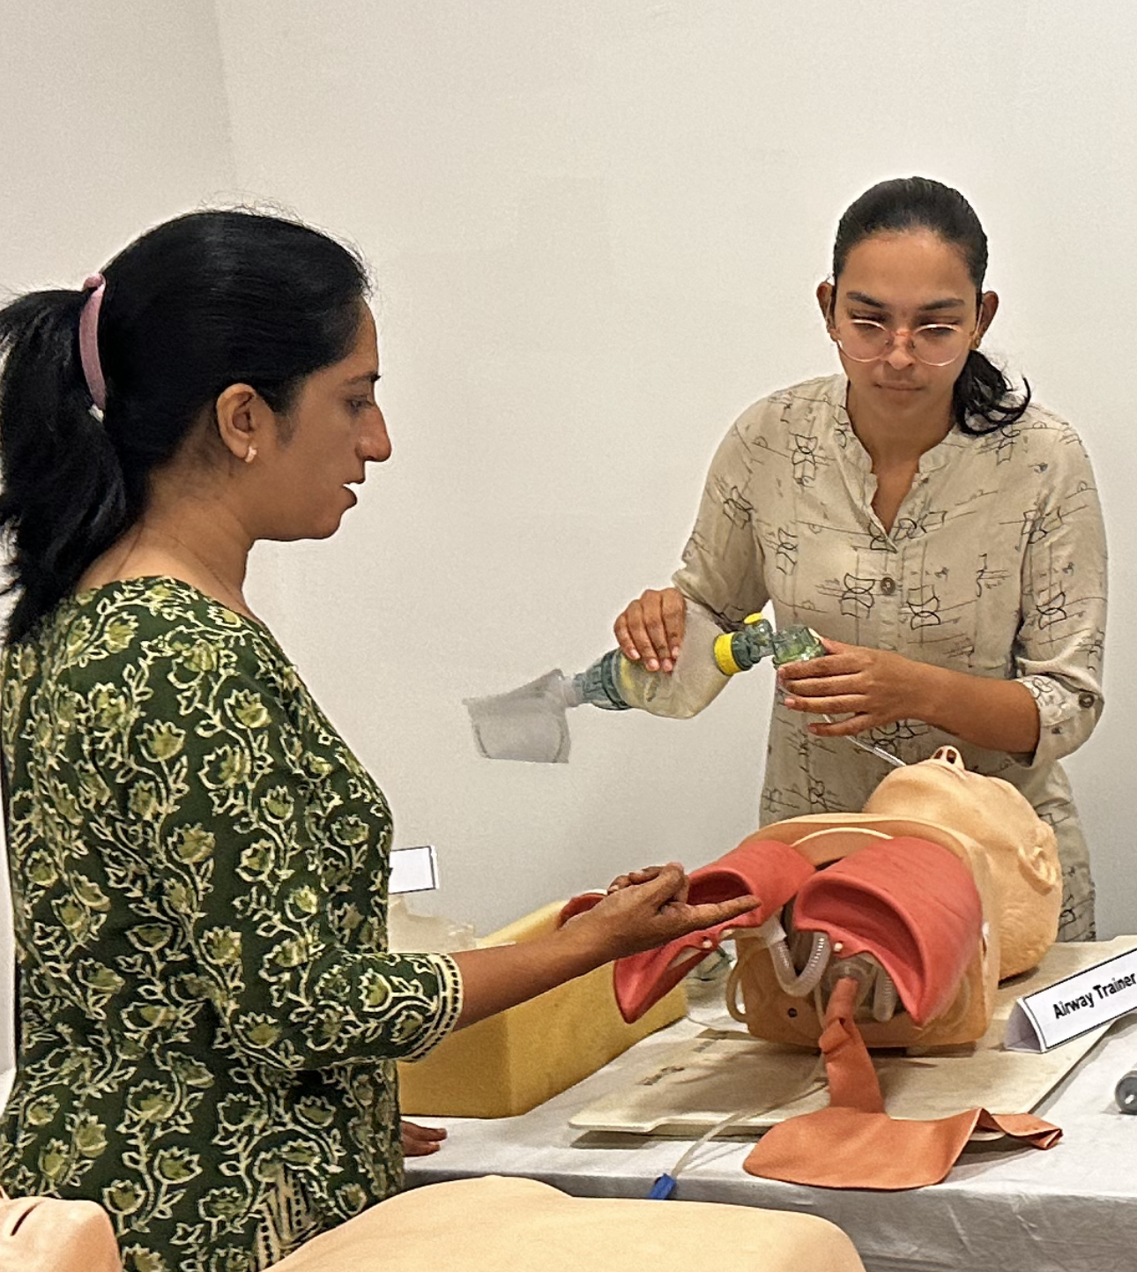
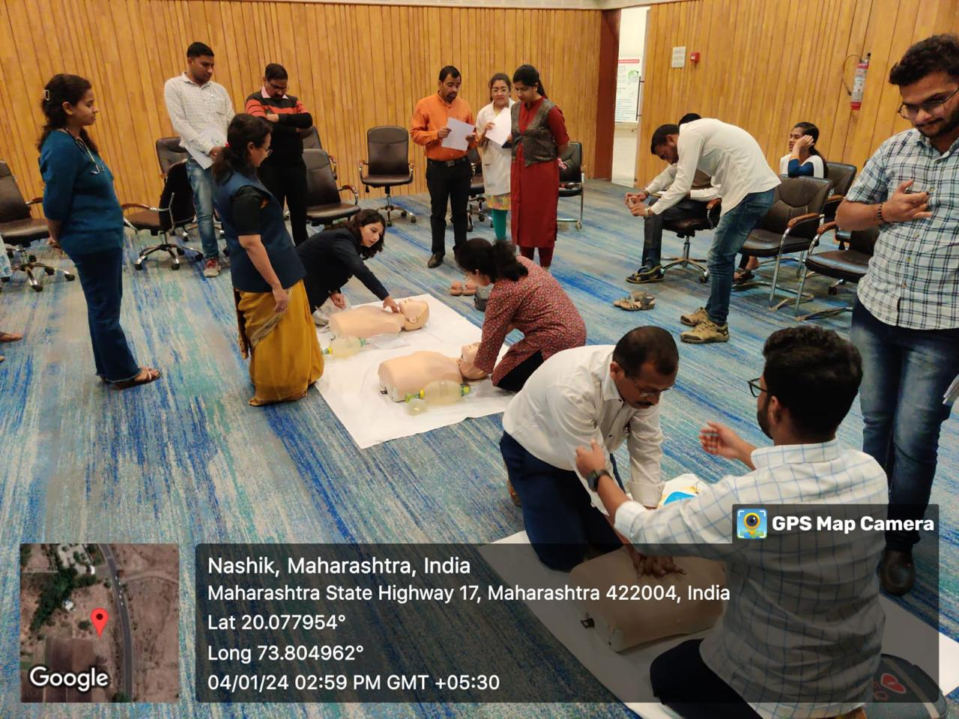
MUHS-SIMULATION LAB MAHARASHTRA UNIVERSITY OF HEALTH SCIENCES
Strategic initiatives:
Training clinical skills to postgraduate and undergraduate students every month
Training BLS to nursing staff in the hospital
Utilising skill lab facilities for educating MUHS faculties about COLS
Camps in Nashik district for giving COLS training to lay people
Core values:
Knowledge
Attitude
Responsiveness

